Slide 1
BITI1113 ARTIFICIAL INTELLIGENCE
Intrusion Detection System using Face Recognition by:
Wan Mohammad Faisal bin Sammio B031720043
Nor Muhammad Firdaus bin Shamsuddin B031720002
Hazeq Imran bin Fadil B031810121

Slide 2
Objective
Real time face recognition: Here, face recognition is used to identify a person on the spot and grant access.
To implement Intrusion Detection System in the webcam.
To give alert if intruder is detected.

Slide 3
What is Face Detection
Face detection is a computer technology that determines the locations and sizes of human faces. It detects facial features and ignores anything else, such as buildings, trees and bodies.
It might then use a genetic algorithm to detect facial regions including eyebrows, the mouth, nose, nostrils and the iris. The algorithm would first identify possible facial regions and then apply additional testing in order to validate.

Slide 4
METHODOLOGY
Facial Dataset
For this project, the dataset is gathered by taking pictures of the person whom the AI will be need to identify. The picture is taken from their social media, and/or is taken face - to - face. Each person has their own folder of dataset, containing average of 5 pictures per folder for training purpose.
Deep Learning
Deep Learning is the method used for this project to train the AI. The dataset gathered is then feed to the AI. The training process takes time with an average of 20 minutes, depending on the environment’s hardware capacity.
Troubleshooting
Troubleshooting is done in case the code spewed errors and whether the training is enough for the AI to accurately recognize the person’s face.

Slide 5
Face Detection using Haar Cascades
Object Detection using Haar feature-based cascade classifiers is an effective object detection method proposed by Paul Viola and Michael Jones in their paper, "Rapid Object Detection using a Boosted Cascade of Simple Features" in 2001. It is a machine learning based approach where a cascade function is trained from a lot of positive and negative images. It is then used to detect objects in other images.
Here we will work with face detection. Initially, the algorithm needs a lot of positive images (images of faces) and negative images (images without faces) to train the classifier. Then we need to extract features from it. They are just like our convolutional kernel. Each feature is a single value obtained by subtracting sum of pixels under the white rectangle from sum of pixels under the black rectangle.

Slide 6
Haar-cascade Detection in OpenCV
OpenCV comes with a trainer as well as detector. If you want to train your own classifier for any object like car, planes etc. you can use OpenCV to create one.
Here we will deal with detection. OpenCV already contains many pre-trained classifiers for face, eyes, smiles, etc. Those XML files are stored in the opencv/data/haarcascades/ folder. Let's create a face and eye detector with OpenCV.

Slide 7
Haar-cascade Detection in OpenCV (cont)
First we need to load the required XML classifiers. Then load our input image (or video) in grayscale mode.
import numpy as np
import cv2 as cv
face_cascade = cv.CascadeClassifier('haarcascade_frontalface_default.xml')
eye_cascade = cv.CascadeClassifier('haarcascade_eye.xml')
img = cv.imread(‘faisal.jpg')
gray = cv.cvtColor(img, cv.COLOR_BGR2GRAY)

Slide 8
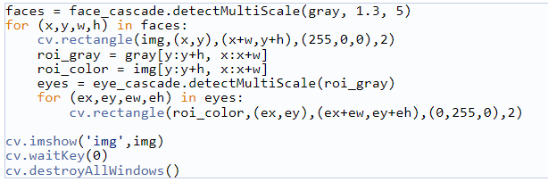
Now we find the faces in the image. If faces are found, it returns the positions of detected faces as Rect(x,y,w,h). Once we get these locations, we can create a ROI for the face and apply eye detection on this ROI (since eyes are always on the face !!! ).

Slide 9
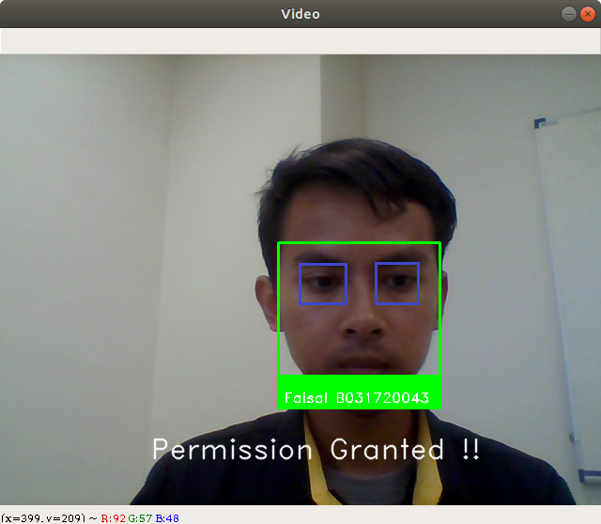
Result looks like below:

Slide 10
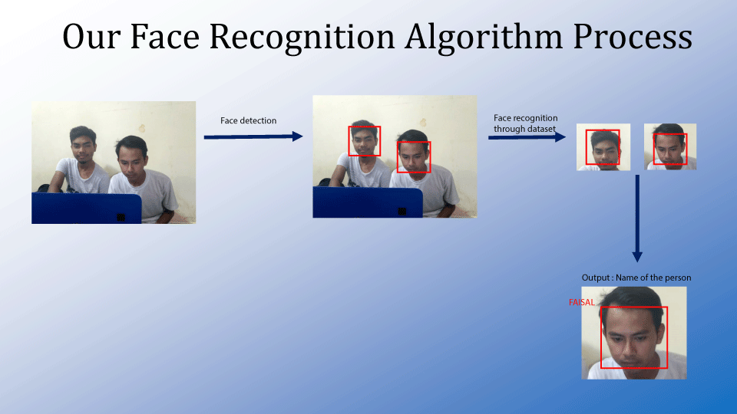

Slide 11
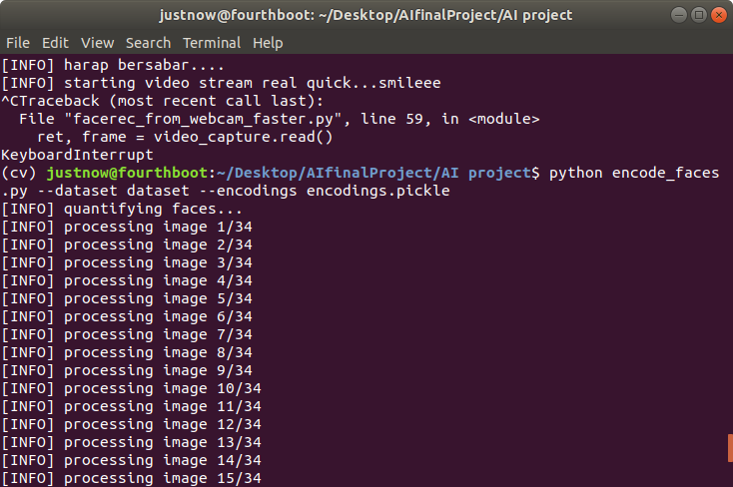
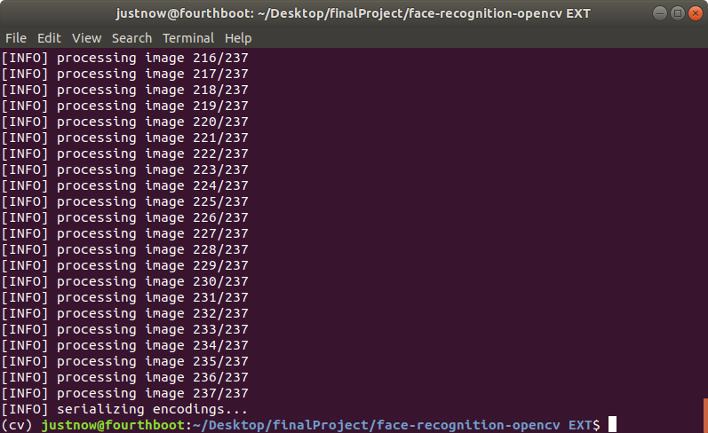
Train dataset

Slide 12
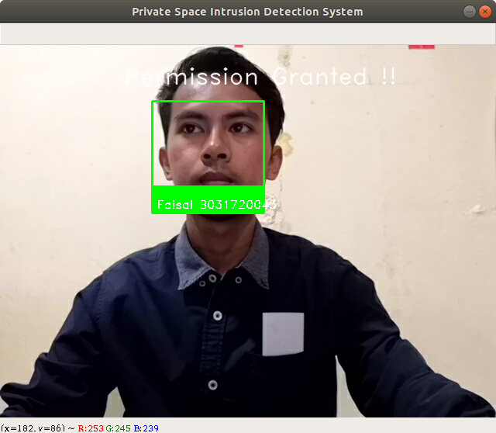
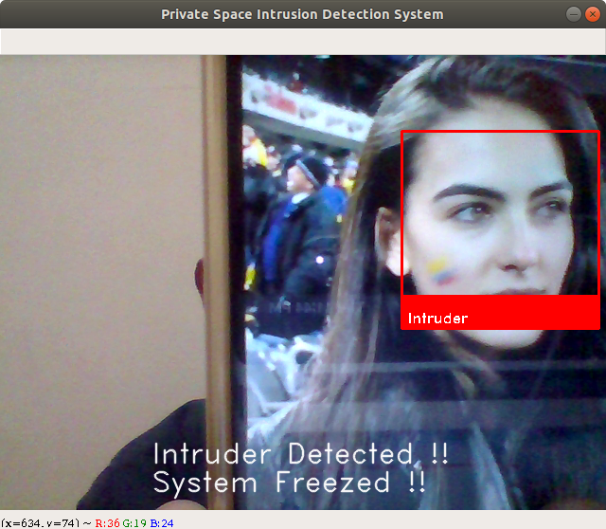
Permission granted if dataset is in database
Permission denied if dataset is not exist in database
Notes:
Install your face recognition libraries
In order to perform face recognition with Python and OpenCV we need to install two additional libraries:
- dlib
- face_recognition
- Install imutils

Slide 13
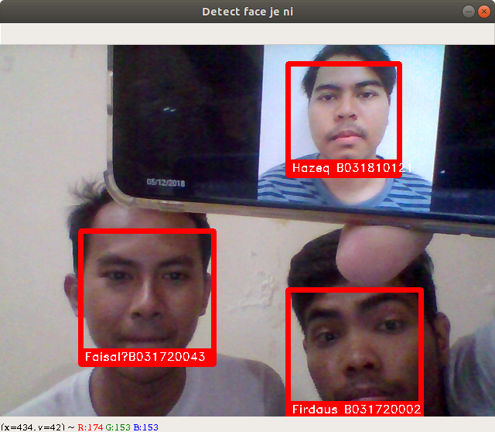
Face recognition of our team members
Hazeq does not get home yet, so we just use his picture.

Slide 14
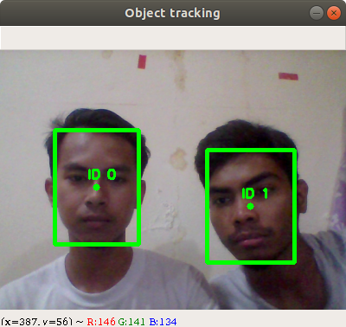
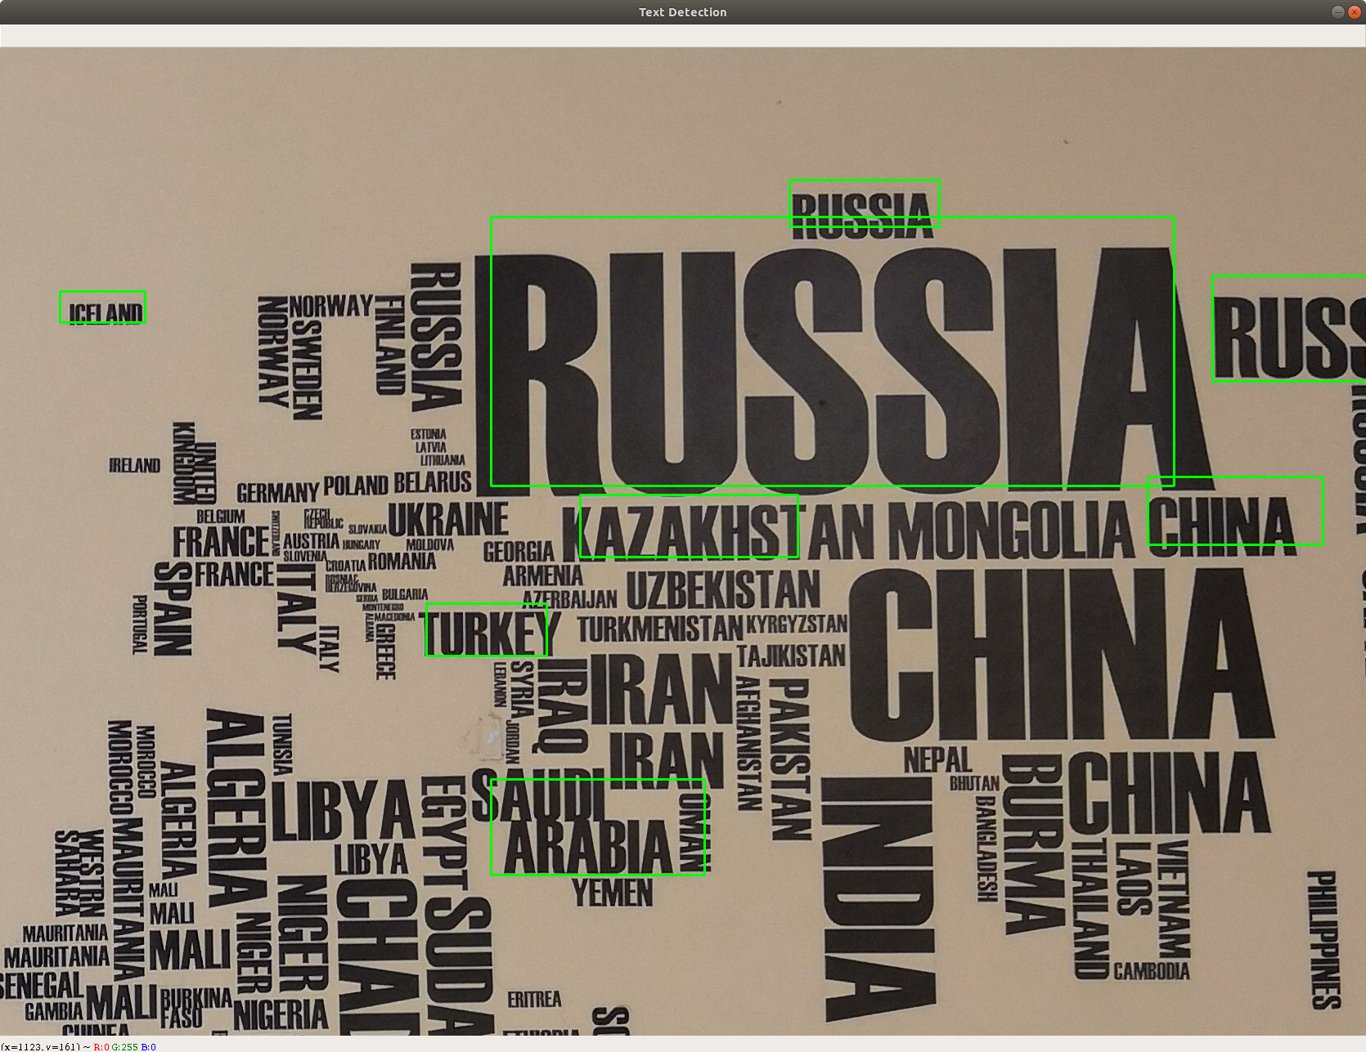
Object tracking and text recognition
Object tracking
Text recognition :
Who can guess where it is haha…

Slide 15
DEMO

